Slide 1
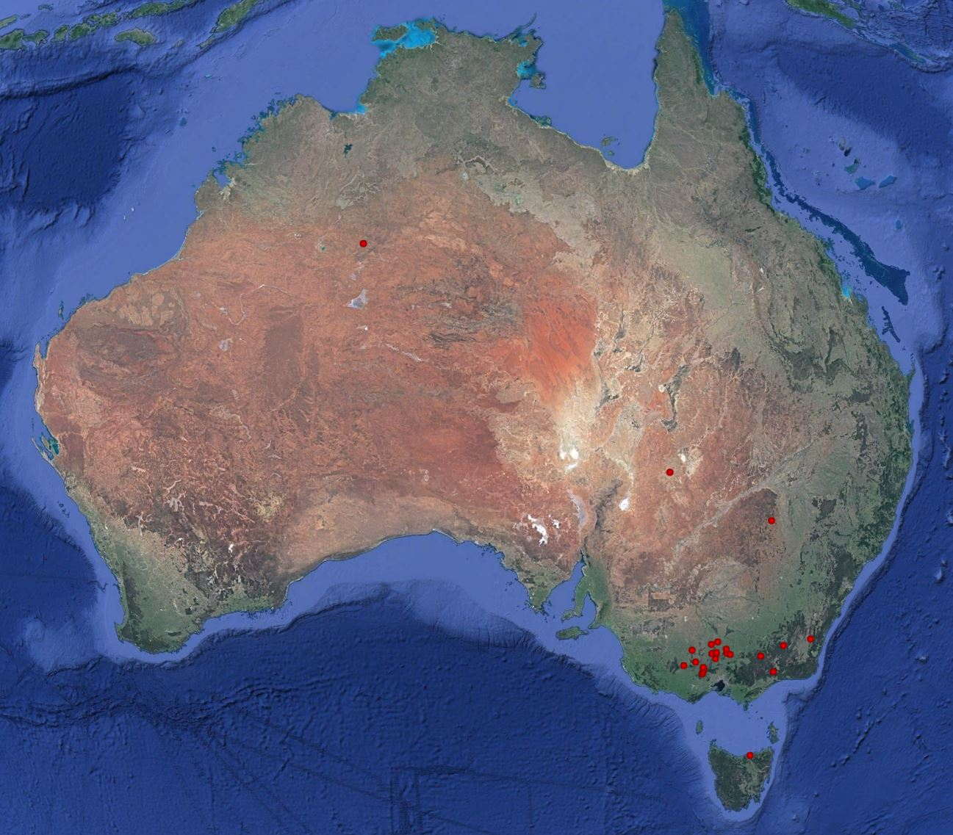
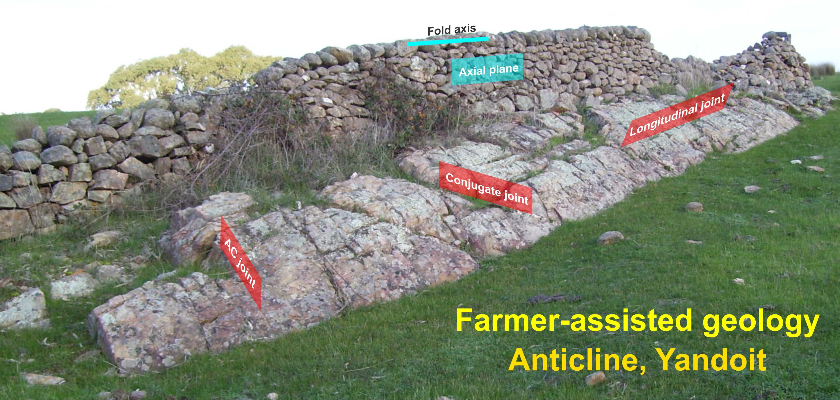
How far did my fault move?
Plus other conundrums you can solve with stratigraphy.
Rodney Boucher
Linex Pty Ltd
27/3/24

Slide 2
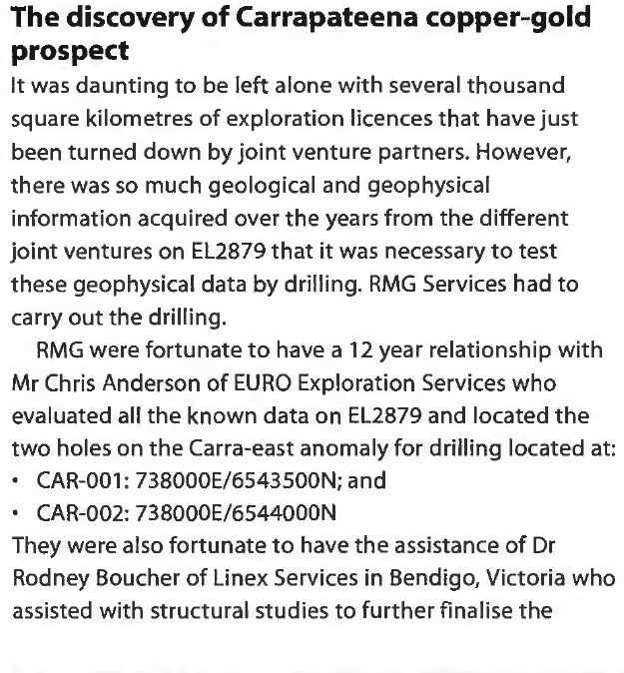

Dr Rodney Boucher
25 years of
turbidites
1994-1997: Petroleum Geology
1997-Present: Linex Pty Ltd
  Turbidites
  IOCGU, U, Porphyry, VHMS, Geothermal
2000-Present: La Trobe Uni Bendigo. Geology of Gold. TESEP
2004-Present: AIG Victoria

Slide 3
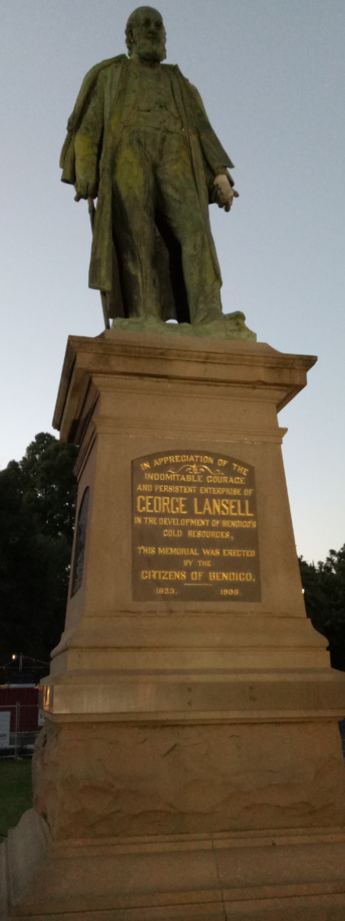
Exploration
Outside
Victoria
SA:
  Carrapateena
NSW:
  Constellation
Gomez, 2006

Slide 4
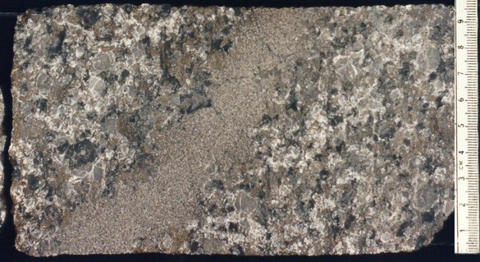
Cooper Basin oil drilling 1995
What is this?
Sandstone
Limestone
Conglomerate
Other
GRANITE
Notes:
There are opportunities for new discoveries. New discoveries & breakthroughs benefit your company and help make a name for yourself, making yourself valuable to the company. But be careful, don’t get sidetracked, you still have a job to do (most of my breakthroughs have come from putting in extra yards outside normal work hours). Also be careful if you are about to tread on toes.
Being observant & objective becomes a habit. One I brought with me to gold exploration.

Slide 5
Lesson
Be observant & objective
  Get your first year geology right!
Find 5 minutes for geological observations & ideas
GRANITE

Slide 6
Contents
PART 1: Tribute to George Lansell
  How did he do it & what can we learn from him?
PART 2: Turbidite-hosted gold deposits
  How to unravel and understand the geology and find gold
PART 3: Methodology (using examples from Wedderburn)
  Logging, reconstruction & interpretation

Slide 7
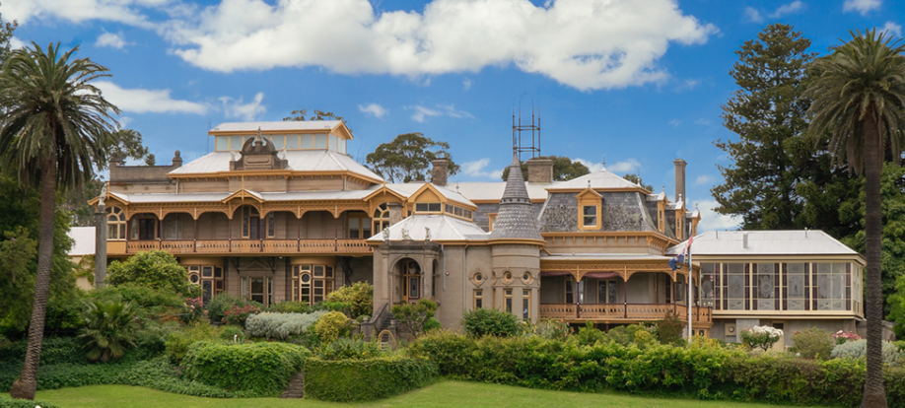
PART 1: TRIBUTE TO
GEORGE LANSELL
Source: fortuna-villa.com

Slide 8
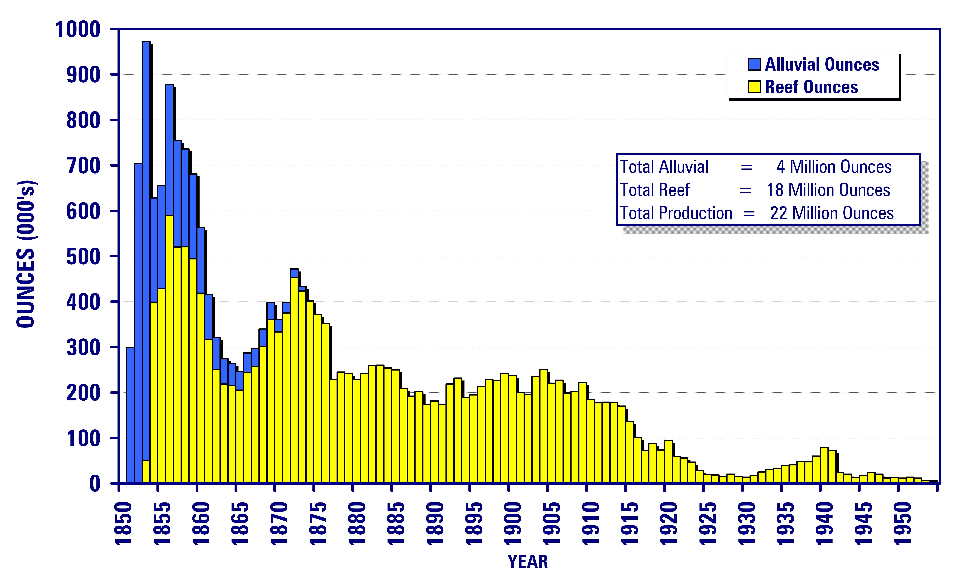
George Lansell
Petitioned to return to Bendigo
Return to England
Purchased Fortuna & Big 180
For £30,000 = 7,700 oz
= $25,000,000 today
Mining success
Purchased Fortuna & Big 180
Died 1906
Gold Mining
Profits from first stopes =
$150,000,000
Candles
Source: Bendigo Mining

Slide 9
George Lansell
Qualities:
  Indominable courage
  Persistent enterprise
  Tough, ruthless
  Practical
  Innovative
  Sought relevant expertise
  Experience

Slide 10
Lord Nelson Mine, St Arnaud
Production 284,000 oz
  (74% of the goldfield)
Was most of St Arnaud’s gold in one mine?
Or was most of St Arnaud’s talent in one mine?

Slide 11
Lansell’s statue
Where are all the other statues?
  Celebrating success
  Celebrating discoverer’s
Downward spiral – failing to demonstrate value to the company, industry and society?

Slide 12
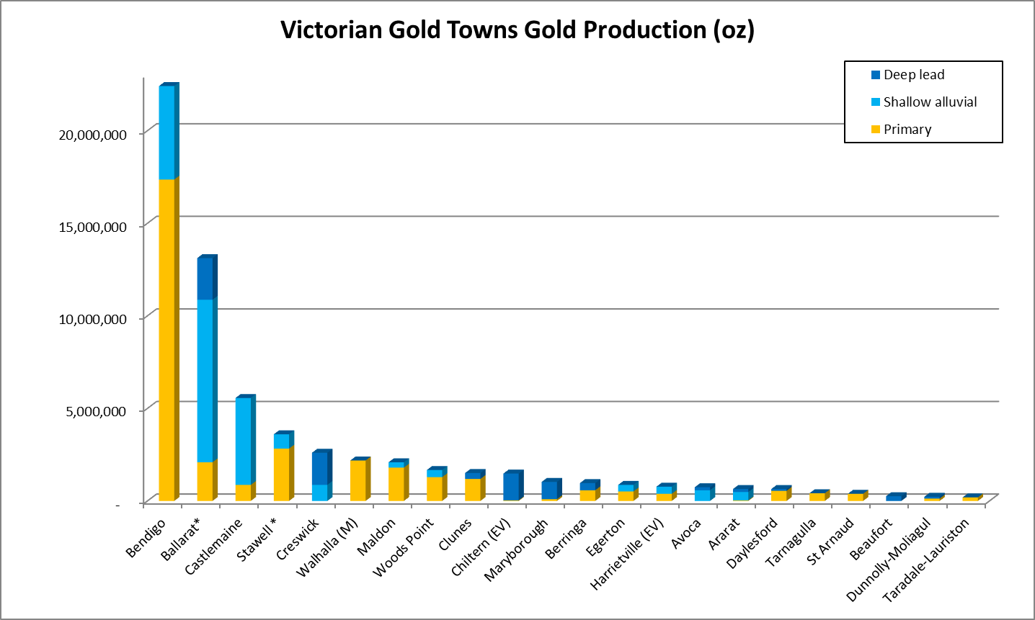
Goldfield production
Production (oz)
+ Fosterville
+ Costerfield
Phillips et al 2003

Slide 13
Exploration of historic goldfields
Can we consider historic goldfields as geochemically defined targets?

Slide 14
Historic geochemical anomalies
S
N
Surface
1000m

Slide 15
Historic geochemical anomalies
S
N
Surface
1000m

Slide 16
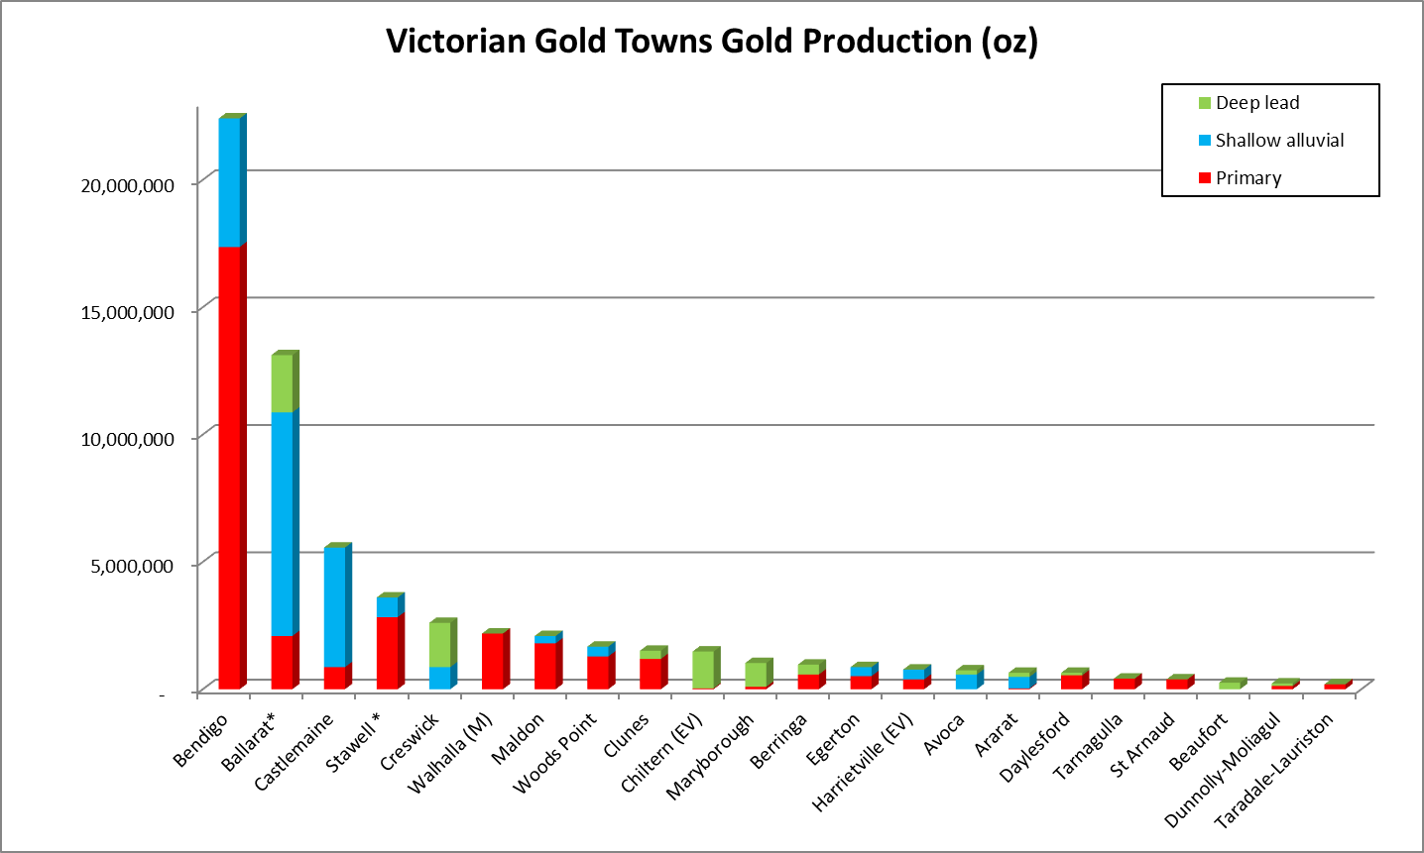
Exploration of historic goldfields
How do we best explore?
How many valid drillholes are required for a valid test?
How do we evaluate the drillholes?

Slide 17
PART 2: TURBIDITE*-HOSTED GOLD DEPOSITS**
*Deep marine sediments
**Low strain, sandy turbidites

Slide 18
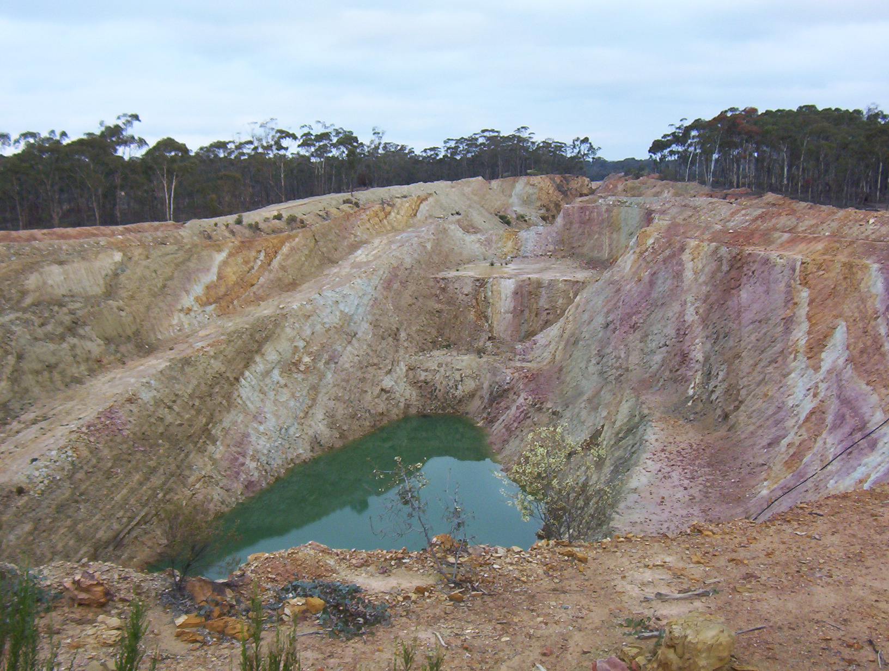
2001: The problem
Beds could be seen to run the length of pits but could not be correlated between drill holes
Fosterville Pit 2003

Slide 19
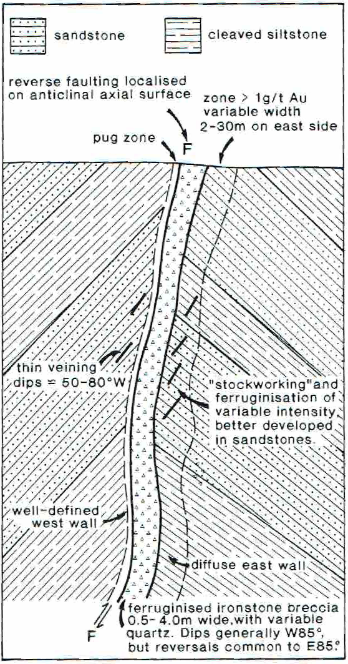
Understanding faults??
Fosterville
McConachy & Swensson, 1990

Slide 20
Turbidite
research \ knowledge \ exploration
Porphyry
Turbidite

Slide 21
Events ~2000
Boom in Victorian data
  Influx of diamond drilling
  Decline development
Sequence Stratigraphy becoming entrenched
Turbidite petroleum exploration boom

Slide 22
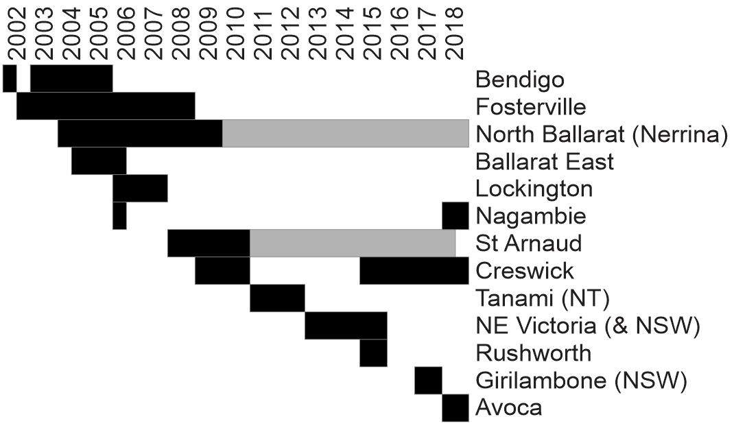
Linex history
*
*
*
CONFIDENTIALITY
INCREASES
COLLABORATION

Slide 23
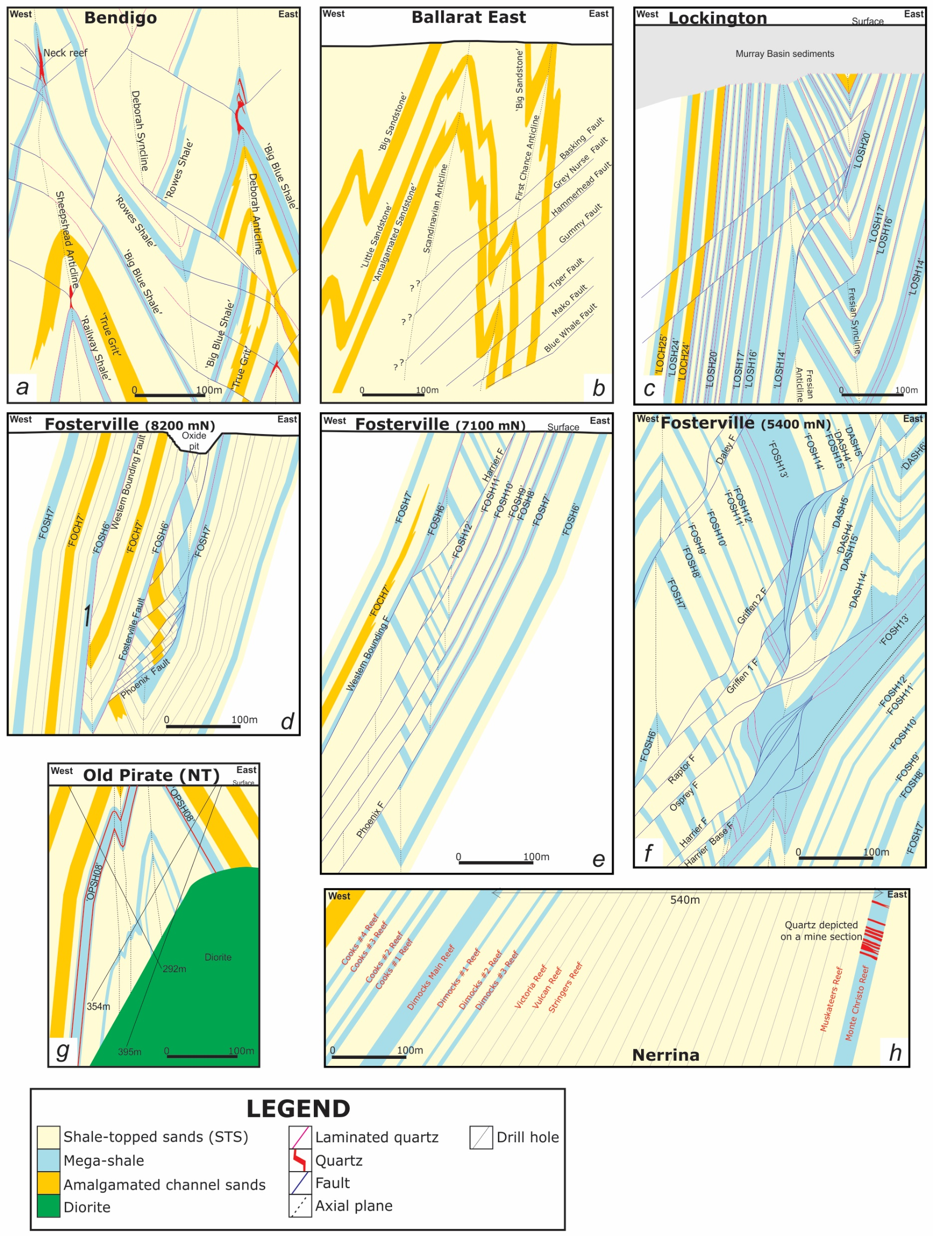
Turbidite-hosted gold deposits
PREMISE 1: No two goldfields are the same
Boucher et al (2008, 2015)

Slide 24
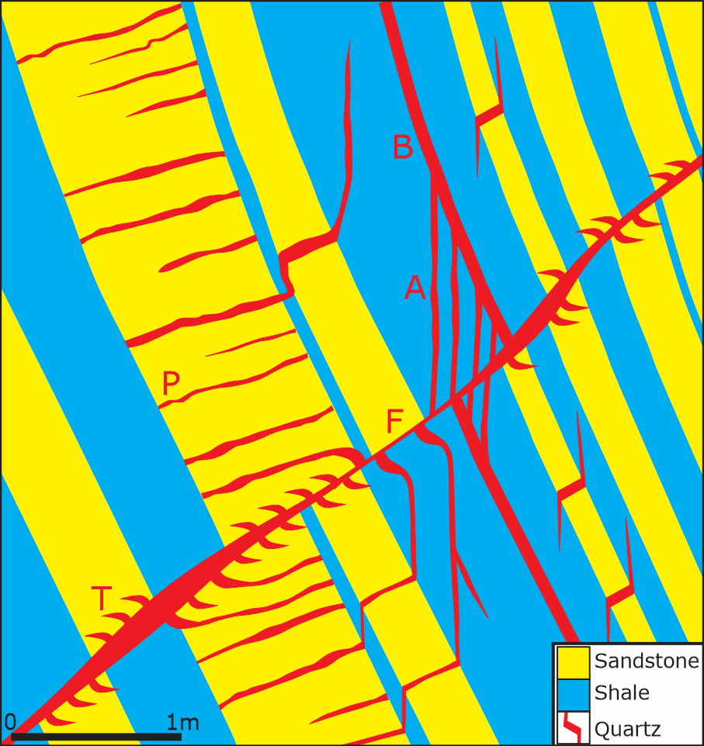
Turbidite-hosted gold deposits
PREMISE 2: Faults are integral
PREMISE 3: Importance of “Favourable beds”
  Rheology
  Traps\fluid pathways
  Controls on vein development

Slide 25
Turbidite-hosted gold deposits
PREMISE 4: We need to map sediments to understand geology

Slide 26
3 ways to use stratigraphy
Navigation/correlation
Structural architecture
  Fault orientation & displacement
  Fold geometry
Vein mapping\ understanding
Boucher et al (2008, 2015)

Slide 27
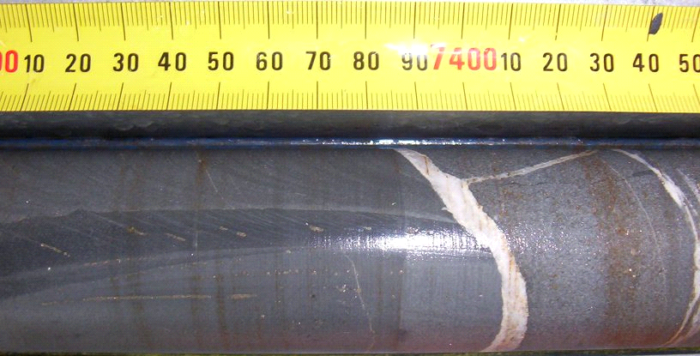
Good core logging
Data collection vs geological understanding (or a sampling exercise)?
Those good at one aren’t necessarily good at the other

Slide 28
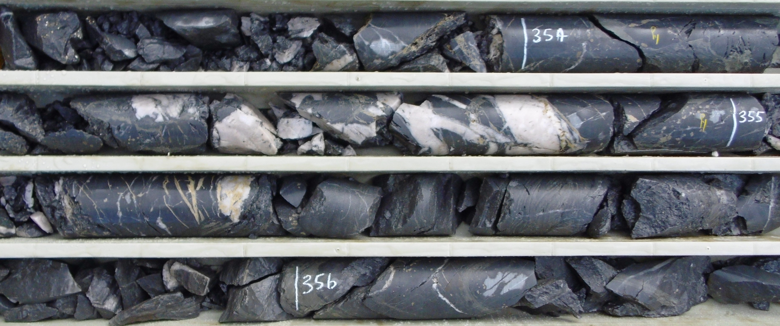
Problems understanding faults
Fault zones don’t reveal their secrets easily
Notes:
Even with core it is often difficult to understand what faults tell us. Broken core is hard to evaluate and we often need to put a lot of effort in to reconstructing fault zones. So we need to apply a few more smarts to understand what is going on and we’ll go through that today.

Slide 29
Experience & expertise
LEVEL 5
LEVEL 4
LEVEL 3
LEVEL 2
LEVEL 1
USEFULNESS
THRESHOLD
YEARS/ABILITY

Slide 30
PART 3: METHOLDOGY
Using examples from Wedderburn

Slide 31
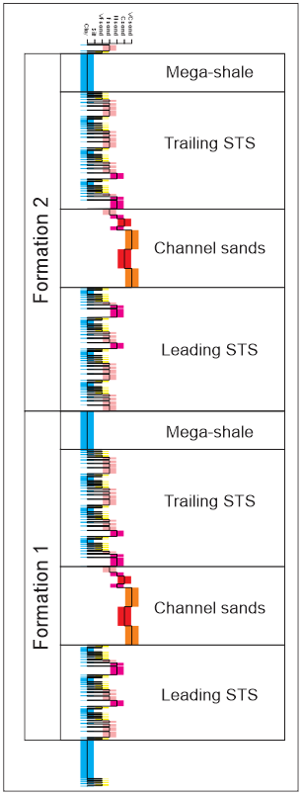
Sedimentological logging
Corrected to true thickness
Enables:
  Bed correlation
  Facies recognition

Slide 32
Reconstruction & interpretation example
Using stratigraphy to find faults
Is there a fault here?
P
Quartz
P
P
P
P
P

Slide 33
Reconstruction & interpretation example
Using stratigraphy to find faults
Is there a fault here?
P
P
P
P
P
P
Reference
stratigraphy

Slide 34
Reconstruction & interpretation example
Using stratigraphy to find faults
Is there a fault here?
P
P
P
F
DATA
LOST
Reference
stratigraphy

Slide 35
Reconstruction & interpretation example
Using stratigraphy to find faults
Is there a fault here?
P
P
DATA
REPEATED
P
F
P
P
P
P
P
P
Reference
stratigraphy

Slide 36
Process when logging
Is there a fault?
Does the fault:
  Repeat stratigraphy?
    Can I find matching beds? In the core and in the log
  Remove stratigraphy?
    Check for matching beds anyway
What is the offset on the fault?
What is the orientation of the fault?
Is there alteration/mineralisation?

Slide 37
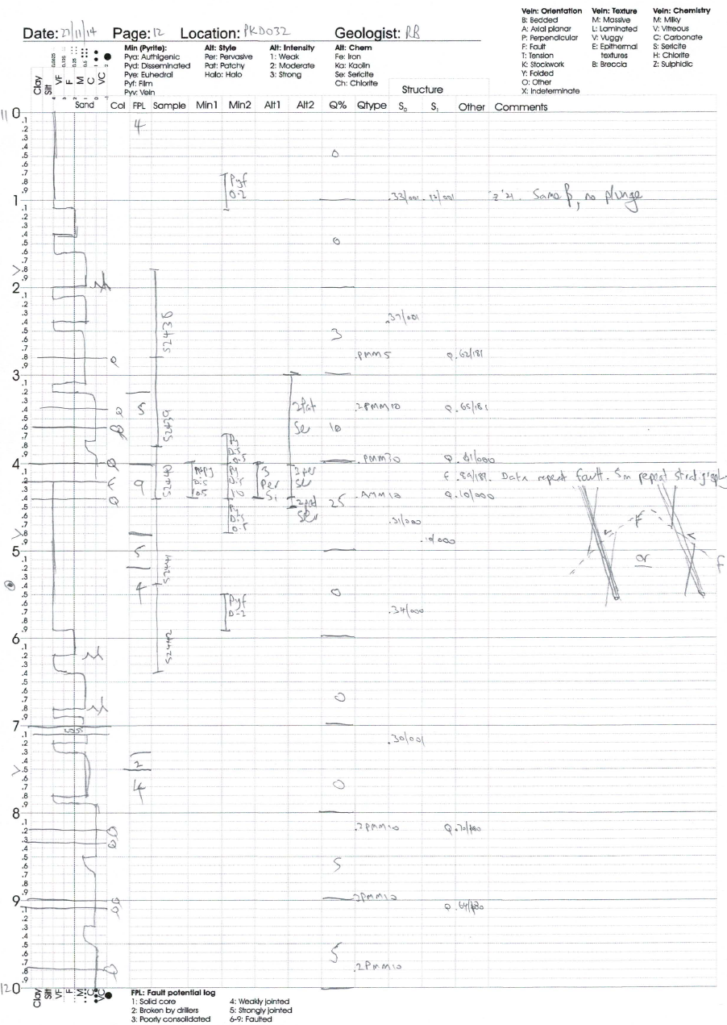
Example log sheet

Slide 38
Wedderburn interpretation 2023
Logging (R Fraser)
Reconstruction (R Boucher)
3D Modelling (R Armit)

Slide 39
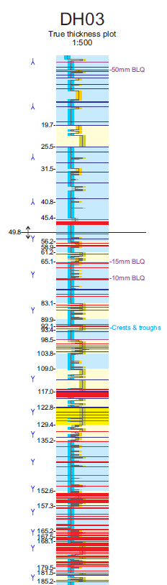
STEP 1: Log the core & plot data
Convert to drilled thickness
Break on domain boundaries
  Faults
  Folds

Slide 40
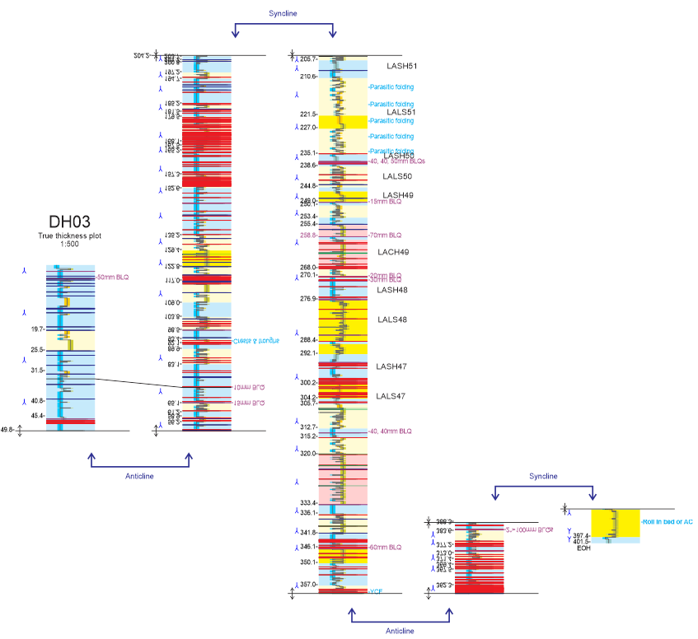
STEP 2: correlation
Within holes & between holes
Break on domain boundaries and correlate

Slide 42
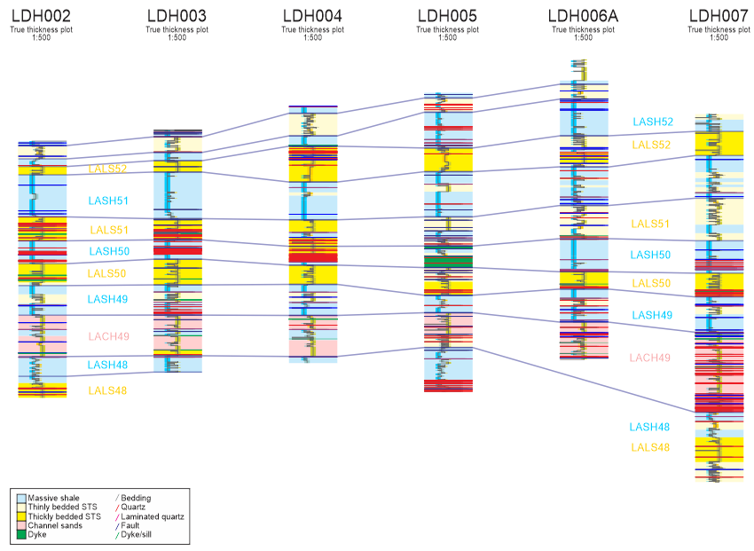

Slide 43
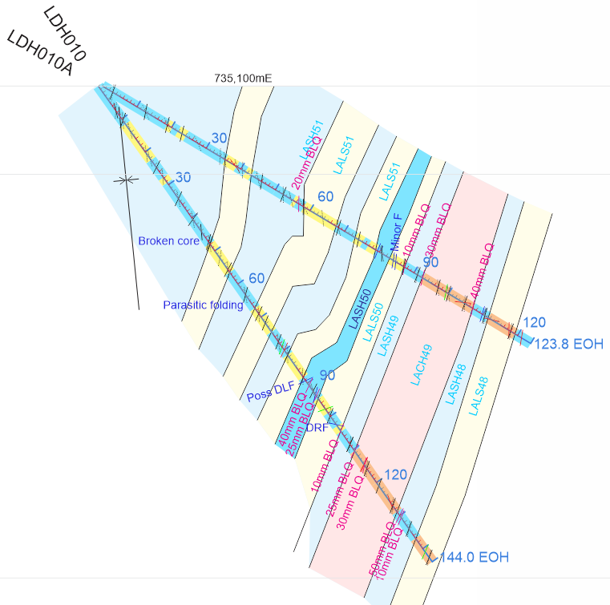
STEP 3: Plot on section
Utilising alpha angles

Slide 44
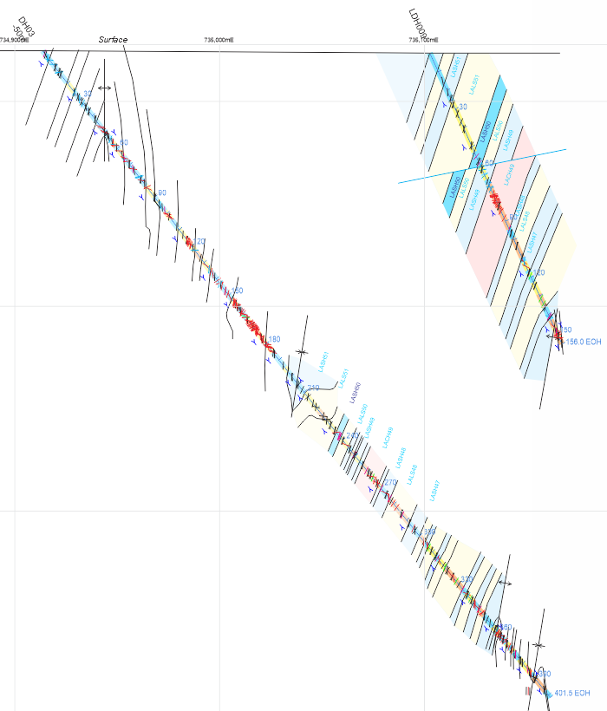

Slide 45
STEP 4: Reconstruction & interpretation
LALS48

Slide 46
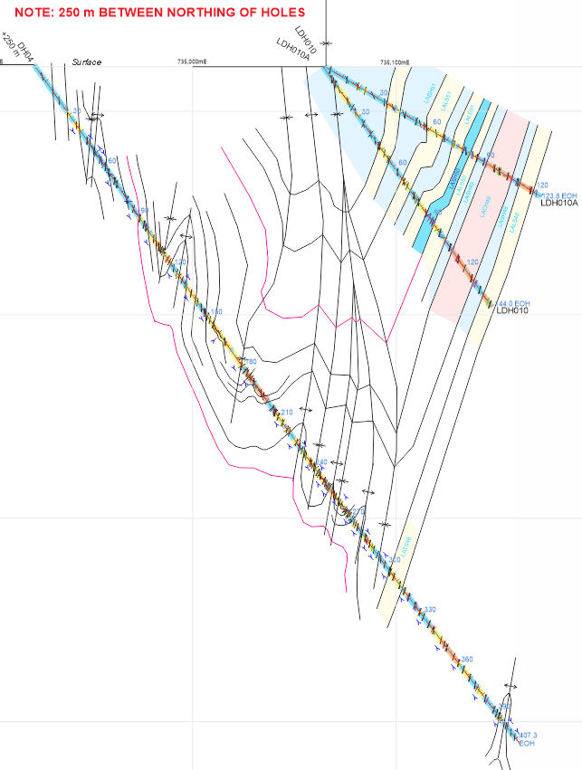
Decollement?
LALS48

Slide 47
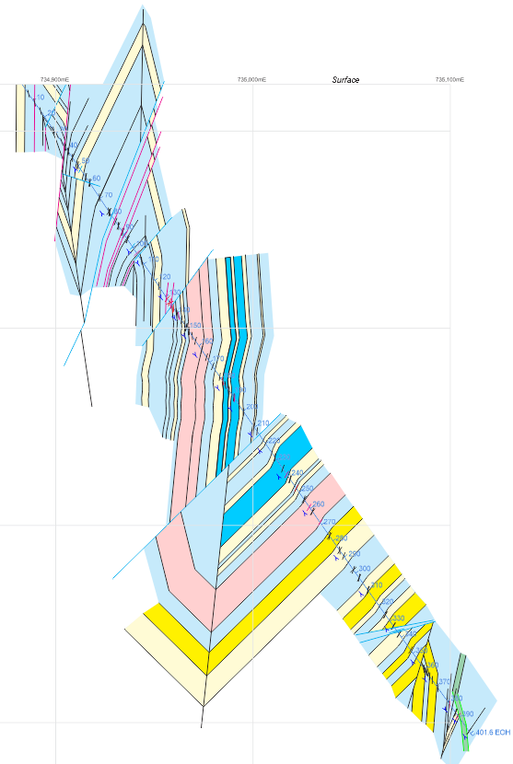
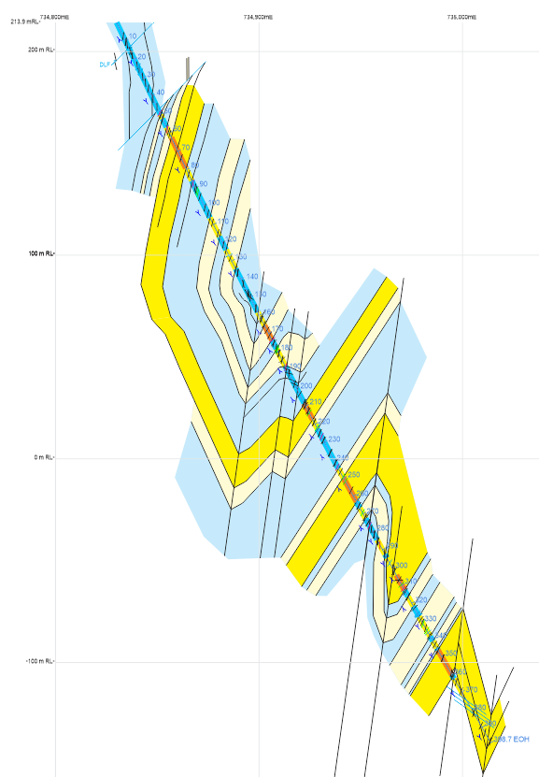
Multiple working hypothesis

Slide 48
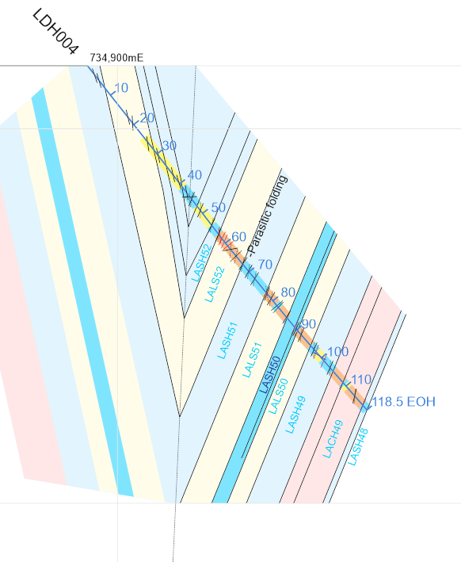
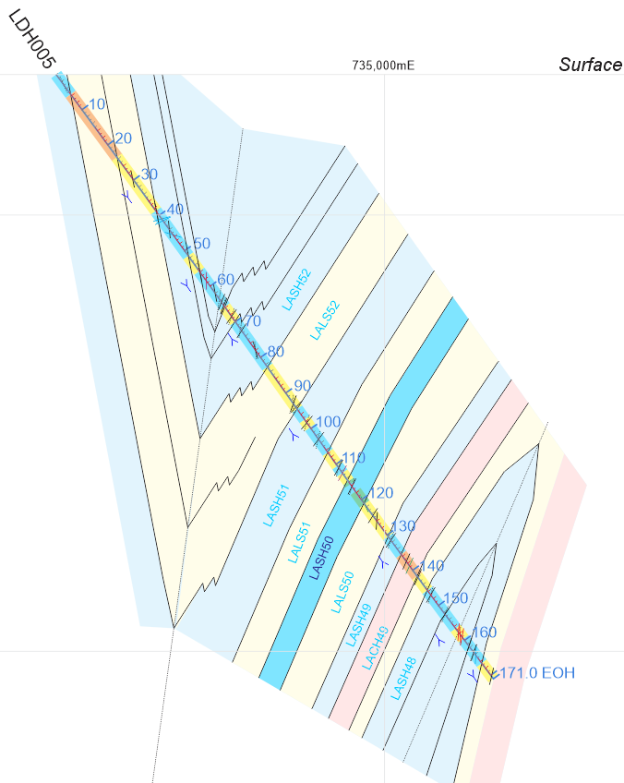
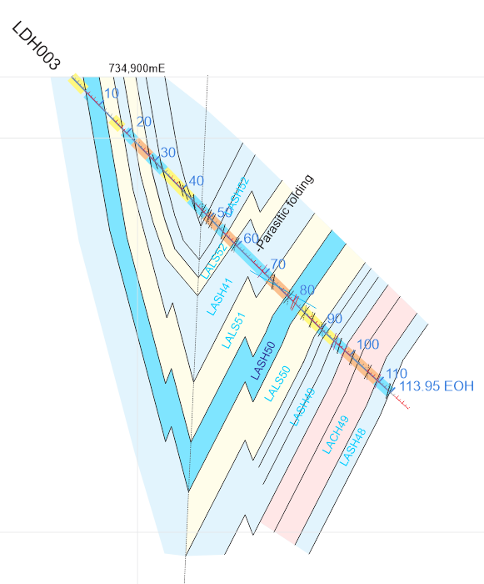
Development of parasitic folding

Slide 49
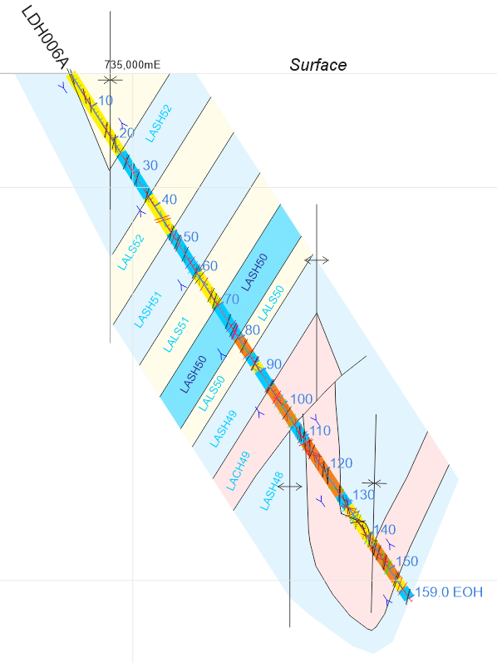
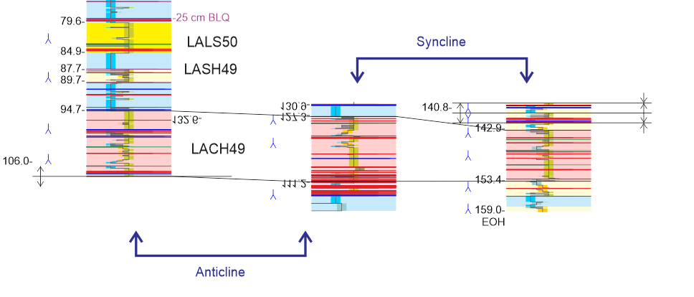
Drill sections

Slide 50
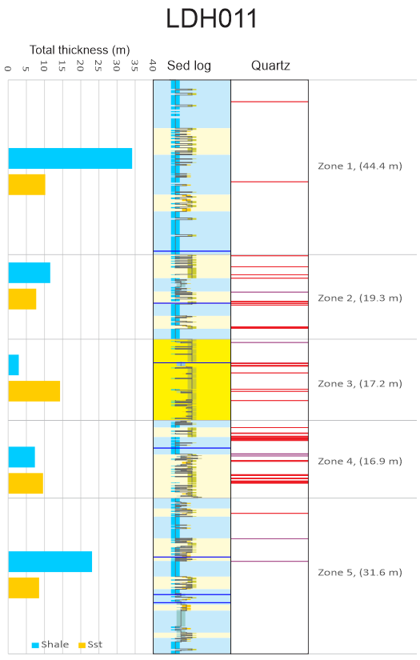
A shale-rich goldfield?

Slide 51
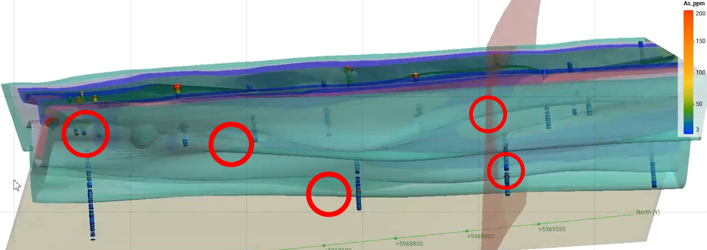
3D model
Plunge insignificant

Slide 52
Historic geochemical anomalies
S
N
Surface
1000m

Slide 53
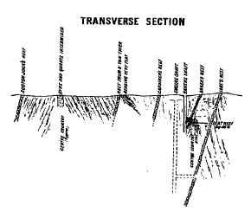
Common ingredients
Variable facies
Laminated quartz veins
Folds (anticlines preferred?)
Limb thrust faults
Dykes
Whitelaw (1911)

Slide 54
What would Lansell do?
If Lansell were at Wedderburn?
  Persistence
  Courage
  Innovative
  Call on expertise
  Bring experience

