Slide 1
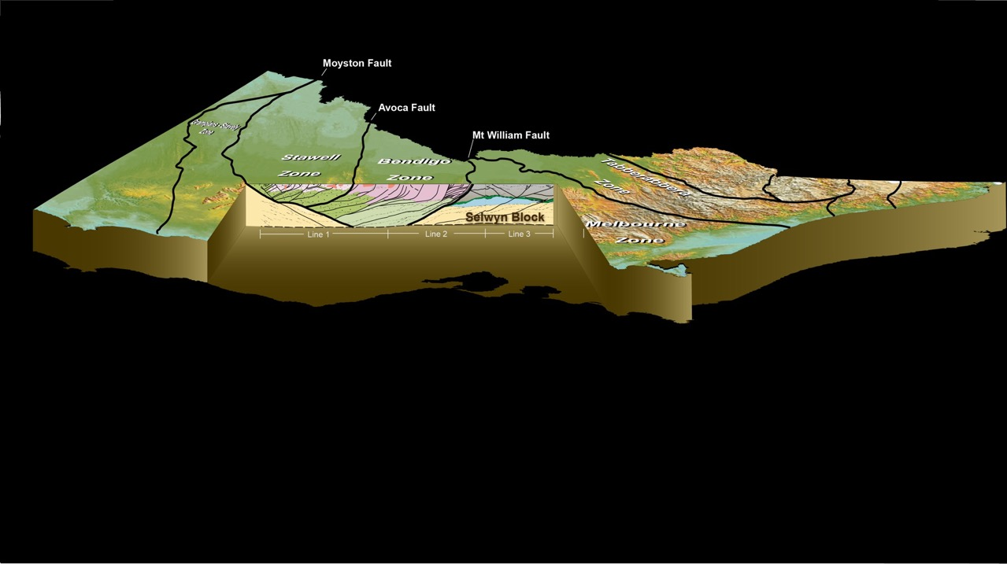
Gold in Victoria
A Big Picture View
Clive Willman
Notes:
Today I want to talk about what we’ve known about the structural controls of gold mineralisation since the 1860s and how 2006 seismic survey puts this knowledge into a brand new perspective

Slide 2
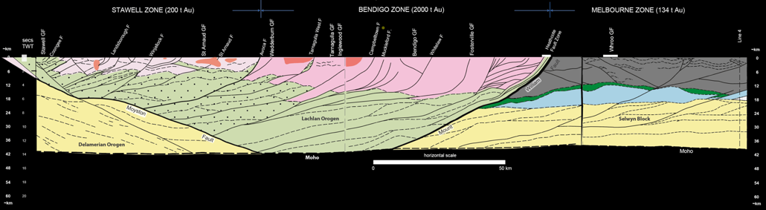
2006 Seismic Survey – Implications for regional distribution of gold
Moyston F.
Line 1
Line 2
Notes:
The 2006 Seismic Survey, was conducted across a 319 km long route comprising 3 overlapping lines.

Slide 3
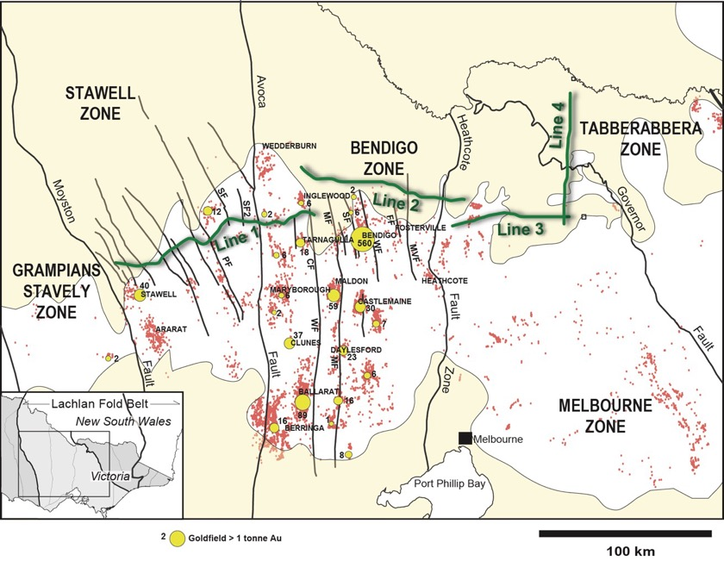
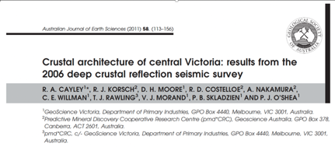
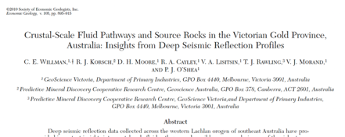
Line 1 = 141 km
Line 2 = 106km
Line 3 = 72 km (Line 4= 78 km)
Total = 319 km (398 km)
Bendigo GF (north end) = 26 km south of Line 2
Wedderburn ~ 27 km north of Line 1
R.A. Cayley, R.J. Korsch, D.H. Moore, R.D. Costelloe, A. Nakamura, C.E. Willman, T.J. Rawling, V.J. Morand, P.B. Skladzien, P.J. O'Shea, 2011. Crustal architecture of central Victoria: results from the 2006 deep crustal reflection seismic survey. Australian journal of Earth Sciences 58, pp. 113-156.
Willman C. E., Korsch R. J., Moore D. H., Cayley R. A., Lisitsin V.A., Rawling T. J., Morand V. J. & O’Shea P. J. 2010. Crustal scale fluid pathways and source rocks in the Victorian Gold Province, Australia: insights from deep seismic reflection profiles. Economic Geology 105, 895–915.
Notes:
This was an historic event in Victorian geology and for the first time, gave us an image of Victoria’s deep crust.
There were two main papers that document the survey results and the implications for mineralisation.
Line 1 = 141 km
Line 2 = 106km
Line 3 = 72 km (Line 4= 78 km)
Total = 319 km (398 km)
Bendigo is 34 km south
Northern extension of Bendigo GF = 26 km south of Line 2

Slide 4
What have we learnt from >150 years
of mining and mapping?
Notes:
To help us understand the interpretation of the survey, in terms of mineralisation, it’s useful to go back and understand what we knew before the survey.

Slide 5
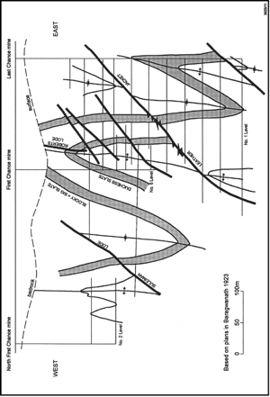
Bendigo Structure
Ballarat
Notes:
For over 160 years we’ve know that folds are the major structural controls at the mine and goldfields scale
The reasons for this strong relationship between folds (and/or bedding) and mineralised lodes is pretty simple. Bedding-parallel laminated veins (LQs) formed early and were folded about fold hinges and very often, limb thrusts are propagated from along these early structural weaknesses, to then cut across the host fold hinge. The saddle reefs at Bendigo formed in this way, Wattle gully is classic variant of this style and even Fosterville seems to be related to this type of limb thrust geometry.

Slide 6
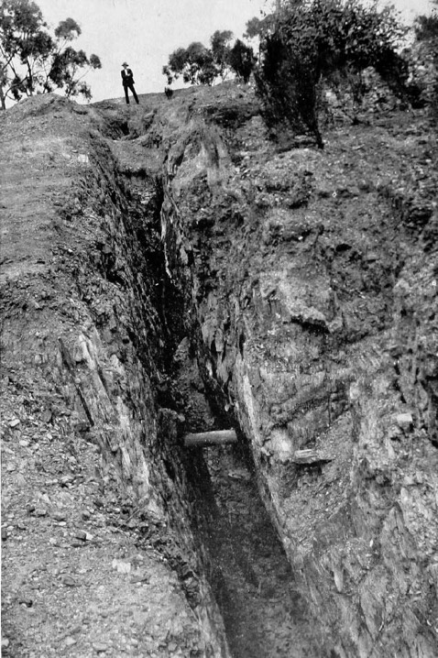
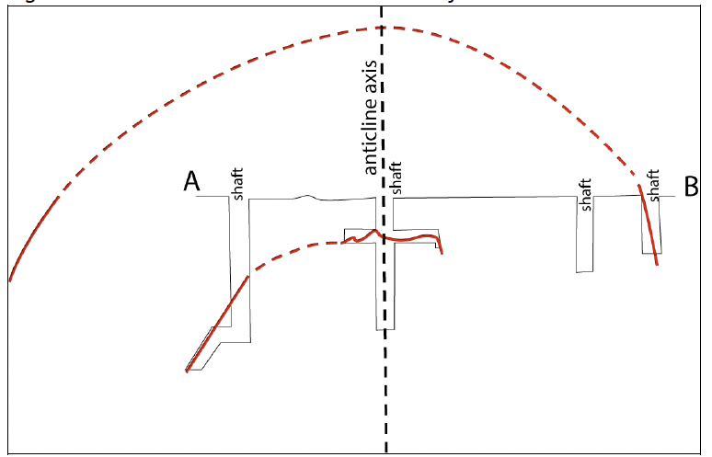
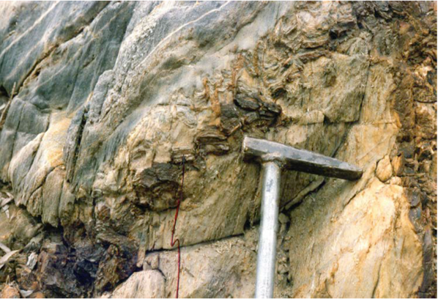
Shaws Reef
20 metres
Lanes Reef
Notes:
And Wedderburn is no different. There we have classic bedding-parallel veins, folded about anticlines. There are limb thrusts in the Lanes Reef deposit that cut across a fold hinge, very similar to elsewhere in Victoria.

Slide 7
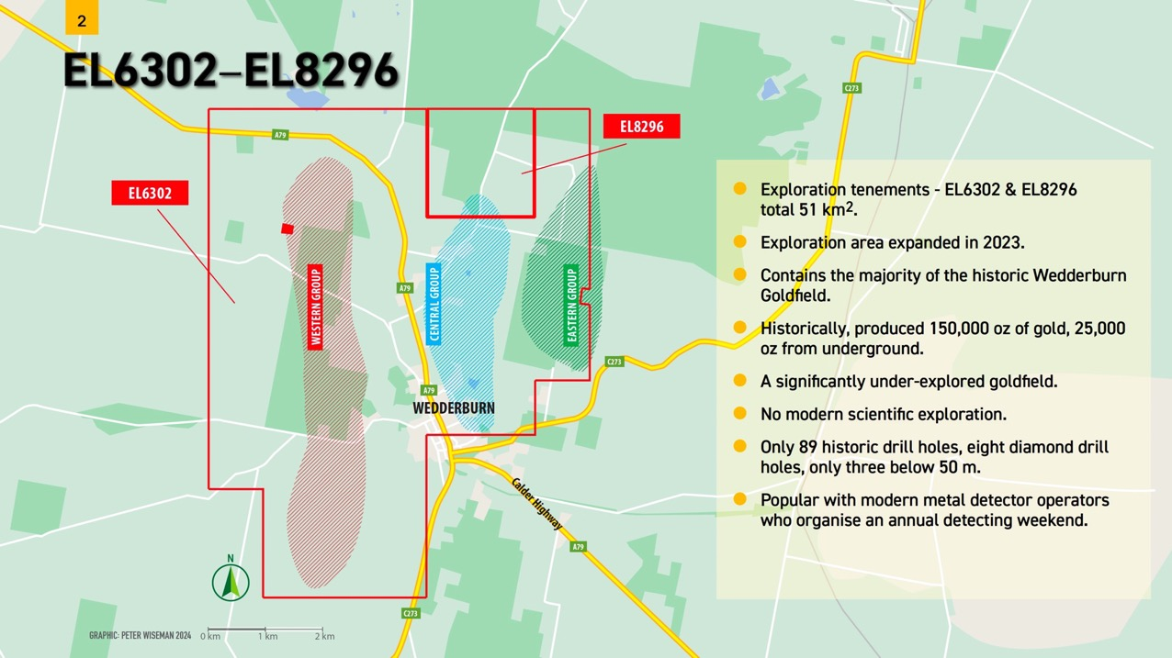
Notes:
The mapping I’ve completed at Wedderburn shows the typical elongation of deposits along strike, parallel to folds. The drilling carried out by Wedderburn Goldfields is within the dashed area.

Slide 8
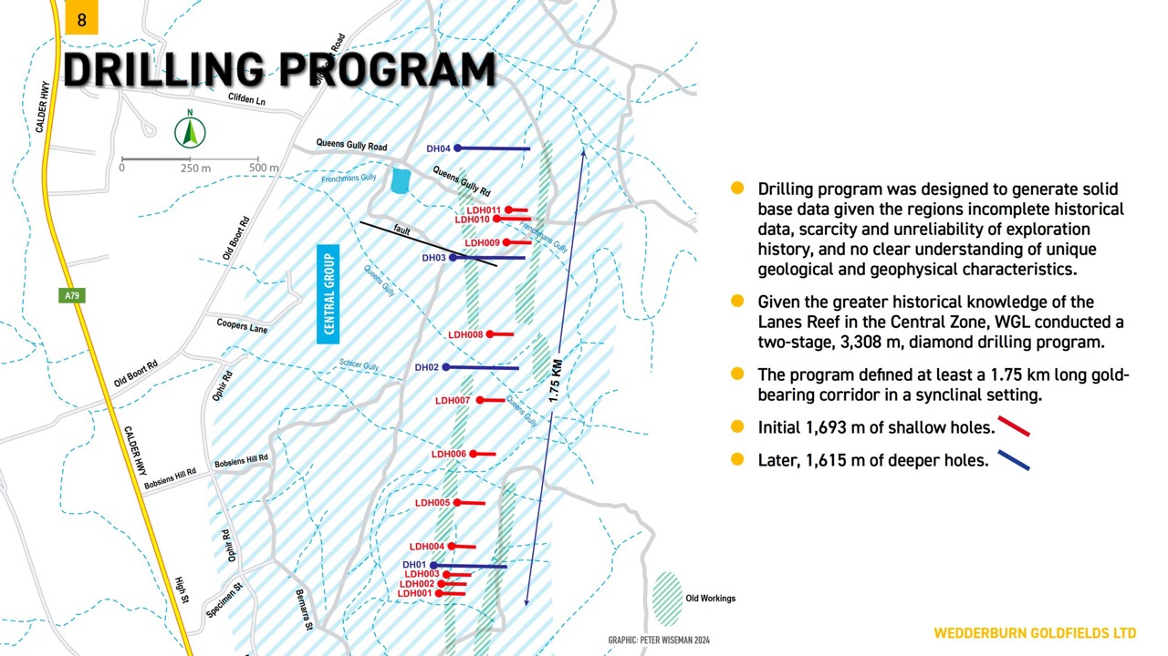

Slide 9
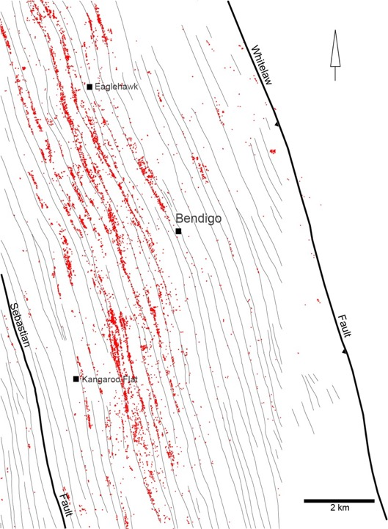
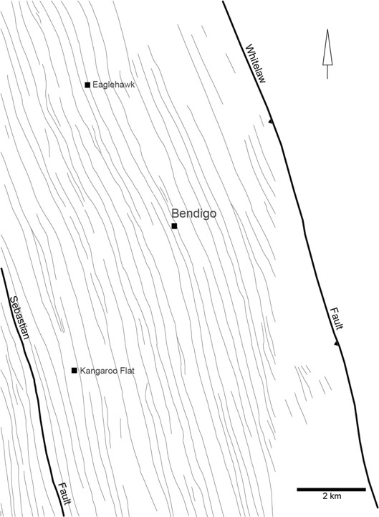
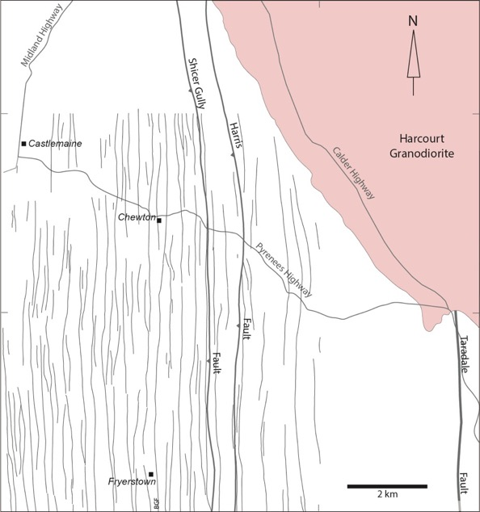
Bendigo
Castlemaine
Notes:
More often than not, mineralised faults are directly related folds and most commonly are generated by fold tightening.
Folds are fundamental structures. If we look at Bendigo and Castlemaine, where we have the most detailed mapping, we can see that folds can be traced for many kilometres along strike.

Slide 10
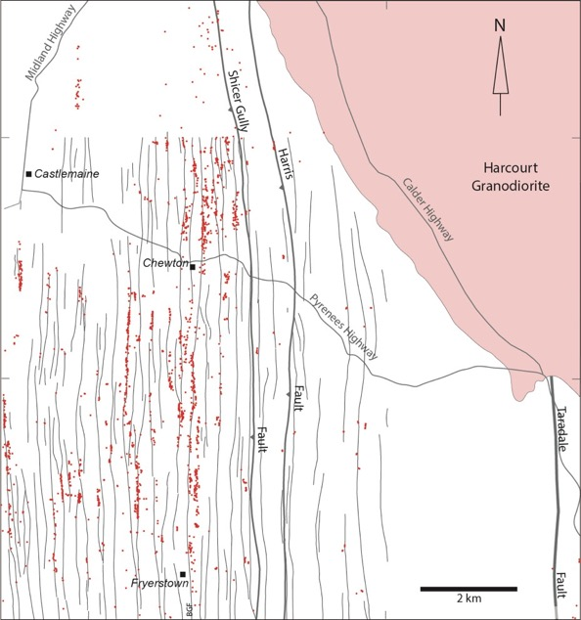
Bendigo
Castlemaine
Notes:
By overlaying the distribution of shafts we can see the extraordinary relationship between folds and mineralisation. At Bendigo some individual folds are mineralised, discontinuously, for some 15 kilometres along strike. At Castlemaine it’s up to about 8 kilometres. The main mineralised belt in the East Ballarat Goldfield is 14 km along strike but only 500 metres wide.

Slide 11
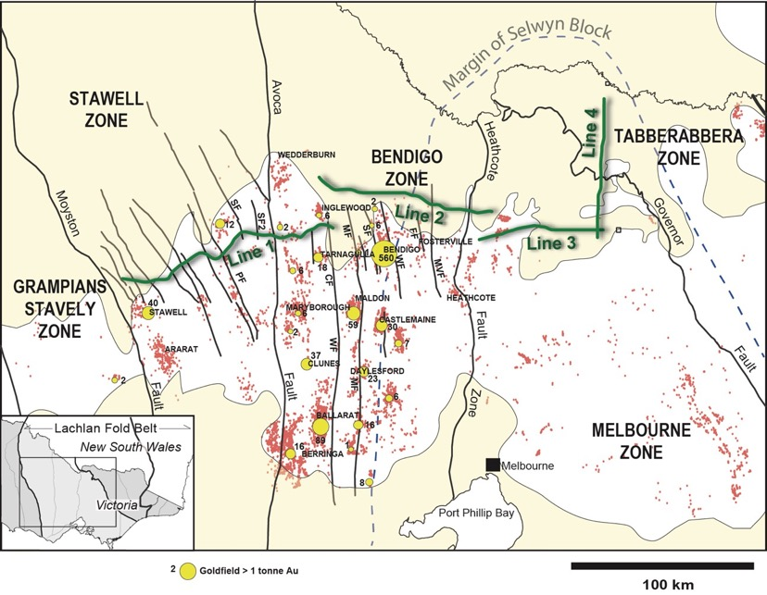
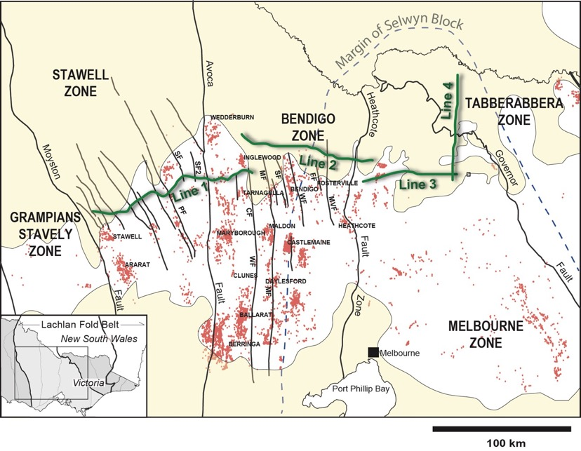
Folds are everywhere across the Bendigo zone – so if mineralisation is solely dependent of folds for structural control, why aren’t goldfields evenly spread across the zone?
Clearly there is a larger-scale structural control imposed on the area that makes some folds traps for gold and others are left barren.
Notes:
Folds are everywhere across the Bendigo and Stawell zones – so if mineralisation is solely dependent of folds for structural control, why aren’t goldfields evenly spread across the zones?
Instead, we see the clustering of deposits into what we call a goldfield. Each goldfield is usually hosted by a set of a few anticlines, and therefore deposits are stretched out along strike – each goldfield is separated by 8 to 30 km of unmineralised folded Ordovician, with no clear or obvious differences in fold geometry
Clearly there is a larger-scale structural control imposed on the area that makes some folds, or groups of folds, important traps for mineralisation while others are left barren.

Slide 12
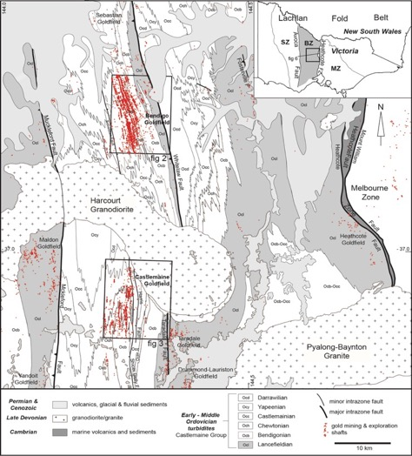
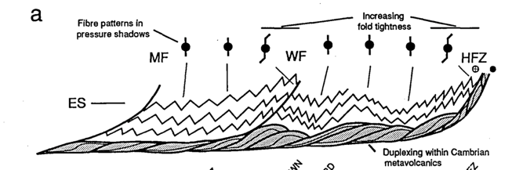
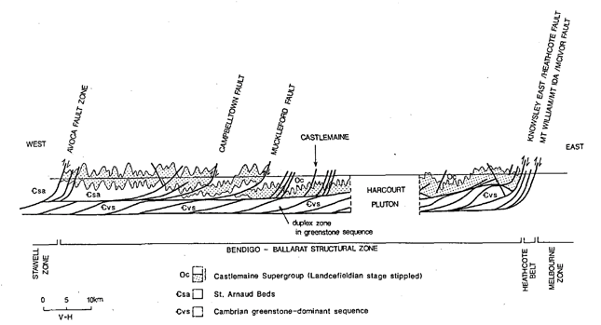
A. Gray & Willman, 1991
Cross-section A
Cox, S. F., Etheridge, M. A., Cas, R. A. F. and Clifford, B. A.(1991). Deformational style of the Castlemaine area, Bendigo-Ballarat Zone: Implications for evolution of crustal structure in central Victoria, Australian Journal of Earth Sciences,38:2,151 — 170
Cross-section B
B. Cox et al, 1983 and 1991
Stephen Cox (1983) theorised that major intrazonal faults may have supplied fluids to goldfields
My question: Can we explain how crustal scale faults interact with folds & fold controlled structures?
Notes:
The first attempt to explain the spacing of goldfields was by Stephen Cox in about 1983 – 23 years before the seismic survey.
Stephen came up with the idea that the location and spacing of gold deposits in the Bendigo Zone are related to major intrazonal faults. He speculated that these major faults were channeling fluids to some areas and not others and given that the spacing of major faults is similar to the spacing of the goldfields.
At the same time other people like David Gray and myself were speculating that the Bendigo and Stawell zones were underlain Cambrian volcanics. And the structural models looked like this, in which major intrazone faults, like the Whitelaw, Muckleford, Campbelltown faults, were listric in profile and would flatten at depth. In 1988 Dave Gray reasoned that the Cambrian volcanics that form the fault slices at Heathcote would underlie the whole region – although others had probably already arrived at that conclusion.
But it was Stephen that first suggested the listric shaped faults might form the plumbing system that dictated where gold deposits in the upper crust would form – although he suggested that it might be blind thrusts that feed the goldfield (this is because the thrusts that we see at the surface are all unmineralised).
If crustal scale faults are responsible for channelling fluids to upper crustal levels, then we need to explain how such faults interact with folds & fold controlled structures?

Slide 13
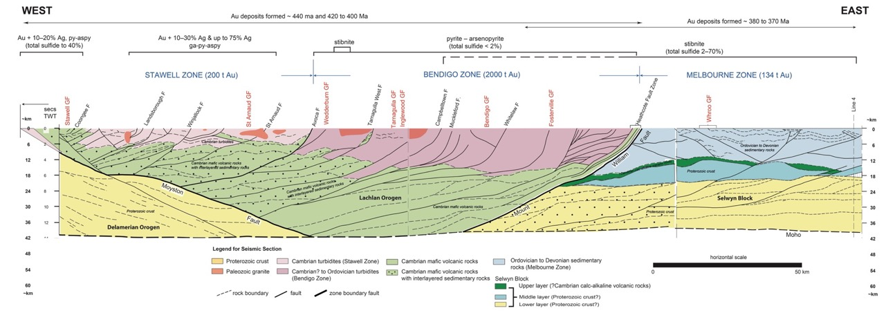

Stratigraphic thicknesses
Cambrian volcanics and sedimentary rocks in HFZ = 2.5km
Castlemaine Group turbidites = > 4km (min 3km)
St Arnaud Group turbidites ~ 6km
Magdala volcanics 0.2 to 1 km (minimum thickness)
Notes:
It wasn’t until 2006 that it was possible to test any of these ideas. And once the survey was completed it was clear we got some things right and some things wrong. We were all on the right track in that the crust has a dual layered structure, compositionally speaking, with upper turbidites and lower imbricated Cambrian volcanics. But the models in early late 80s and early 90s were advocating for a thin-skinned thin-skinned crustal structure – where faults flattened out to a common horizontal decollement surface. In fact that was wrong and it turned out to be a thick-skinned terrain where the the major faults penetrate right down to the lower crust. But the faults were listric in profile, that is - steep at the surface and flattening at depth. They just don’t link to a common decollement zone.

Slide 14
Can we see a relationship between the location of the goldfields & major faults?
Bendigo goldfield sits above inflection point of the Whitelaw Fault
Does mapping show any type relationship between the goldfield and major faults.at surface ?
Notes:
But does the survey show a relationship between the location of goldfields and the major faults as suggested by Cox.
It’s not immediately obvious from the section. But what we can see is that the Bendigo Goldfield sits above the inflection point of the listric fault. On it’s own this could easily coincidental, but it’s an interesting observation.
So we need to ask – is there any type relationship at the surface, that we can see between the goldfield and the fault.
So here we can go back to mapping that was done 15-20 years before the seismic.

Slide 15
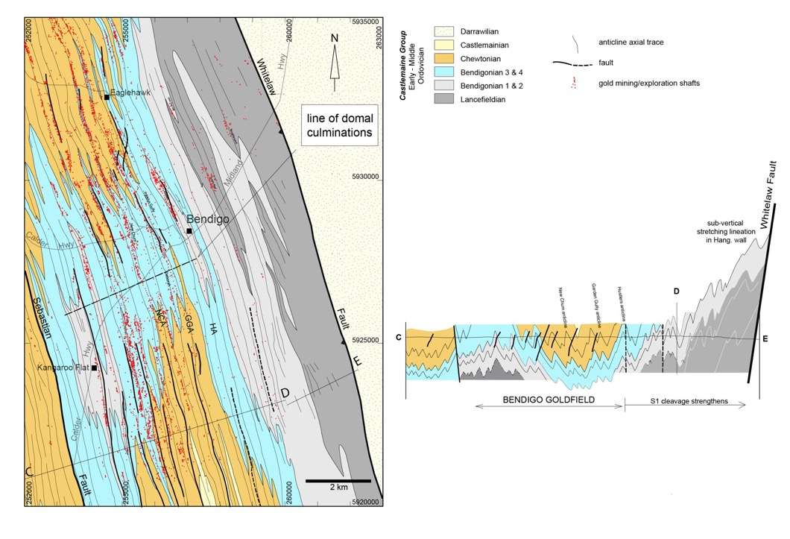
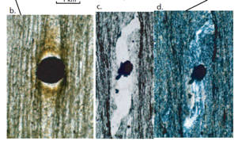
Folds patterns related to proximity to major faults?
Emphasize that major faults are reverse
Mapping: Clive Willman & David Byrne. Biostratigraphy by Clive Willman and Fons VandenBerg
Notes:
So let’s have a look at the fold patterns across Bendigo and Castlemaine Goldfields.
This mapping is based on very detailed 10,000 scale mapping by myself and David Byrne in the 1980s.
The great thing about Bendigo and Castlemaine is that we have great biostratigraphic control by using graptolite fossils. The whole Ordovician sequence is about 3000 metres thick and it’s possible to differentiate different packages of turbidites down to 150 to 200 metres thick. This is good enough to show the broad structure of the two areas. Here the oldest rocks are the grey colours, the mid range aged strata are blue and the youngest strata are orange and yellow. And when you draw a cross-section across the goldfield to include the Whitelaw Fault you see a remarkable change in fold style. The enveloping surface, of the major fold hinges, is horizontal to synclinal across the goldfield but rapidly climbs towards the Whitelaw Fault. This is simply because the folds over here have wide west-dipping limbs and shorter east-dipping limbs. So folds are verging towards the fault and there are other significant features in the hanging wall – such as a vertical mineral lineation, a subtle increase in the strength of S1 cleavage and the slates become almost phyllitic near the hangingwall. At the same time the folds in the east are slightly tighter. All this suggests a higher overall strain in the hangingwall of the Whitelaw Fault. This is similar to the characteristics seen in thrust sheets in other parts of the world.

Slide 16
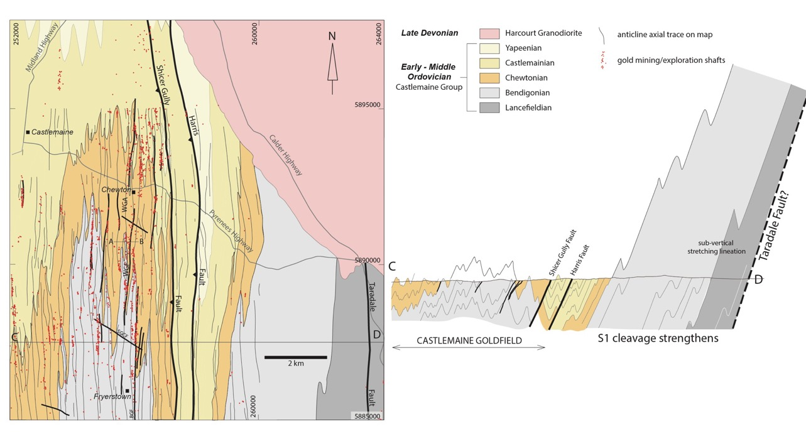
Folds patterns related to proximity to major faults?
16
Notes:
If we look at the same type of section at Castlemaine and Chewton we see an almost identical transition from a flattish enveloping surface which then rapidly climbs east of the goldfield. At the far east end of the section you see similar sub-vertical stretching lineations. And there is a general eastwards intensification of cleavage and tightening of fold hinges. The only problem here is that graptolites are hard to find in the east and so it’s difficult to identify the presence of a major fault analogous to the Whitelaw Fault. But on the basis of the structures I did infer a fault that I named the Taradale Fault - there is some evidence at the surface for the structure.

Slide 17
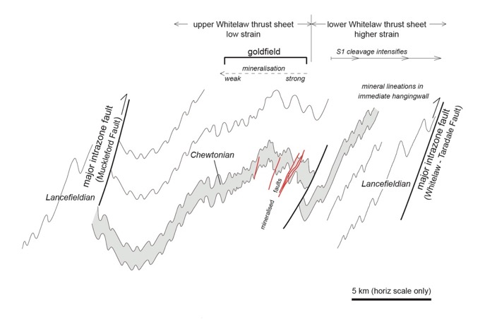
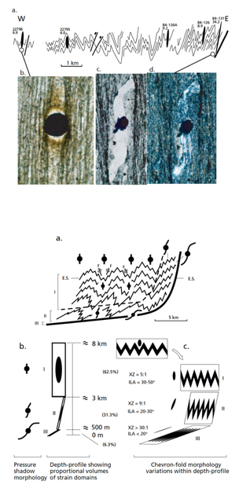
Gray et al 2003 in ‘Geology of Victoria’
Goldfield 3 - 7 km
west of fault
My question: Can we explain how crustal scale faults interact with folds & fold controlled structures?
The Whitelaw Fault and the growth of folds are related
Relationships suggest the siting of the goldfield may be part of this system – it’s possible
But how could it work?
Notes:
So we can summarize these relationships in this diagram – and it suggests that folds and major faults may be related, based on fold vergence patterns, and higher strains in the hangingwalls of the major faults to the east. This implies that the growth of the regional faults and folding were partly coeval. Other major faults show similar high strains zones in their hanging walls – the Muckleford Fault, Redesdale Fault, Heathcote Fault Zone and the Avoca Fault.
But the main thing to take from this is that the major intrazone faults are unmineralised and the goldfield is set back to the west by several kilometres
But what does the seismic survey tell us about this idea and how could it work?
Note: The Avoca, St Arnaud, Percydale and Landsborough faults all have polydeformed and highly strained hangingwalls with west over east kinematic indicators.
The largest antiformal culminations in the Stawell Zone often coincide with large faults, which are regularly spaced across the eastern Stawell Zone.

Slide 18
The observation that Bendigo Goldfield sits above the inflection of Whitelaw Fault is worth considering based on surface relationships – need to have a closer look at the seismic section
The critical observation here is that faults are listric in profile – has implications for fluid flow

Slide 19
The observation that Bendigo Goldfield sits above the inflection of Whitelaw Fault is worth considering based on surface relationships – need to have a closer look at the seismic section
The critical observation here is that faults are listric in profile – has implications for fluid flow

Slide 20

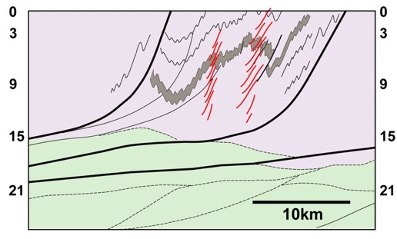
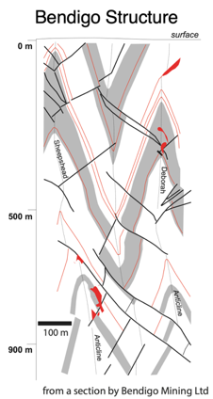

2nd order faults controlled by folding
High angle segment
unfavourably oriented
impermeable
Bendigo
Whitelaw F
Fluid flow
Fluid Escape Zone
Transfers permeability
from 1st order fault to
turbidites
Low angle segment
favourably oriented
steady state deformation
permeable
Notes:
This summaries the relationships between the mapped profile across Bendigo and the shape of the Whitelaw Fault in the seismic survey. We think that the low-angle segments of the fault was more effective fluid pathways because it was favourably oriented for reactivation involving steady-state deformation which maintained permeability over an extended period. By contrast, the high angle segments were unfavourably oriented for reactivation during east-west shortening and were relatively impermeable. If so, this suggests there was a Fluid Escape Zone that coincided with the steepening of the first-order fault.
This escape zone represents a transfer of permeability from the major faults, into networks of smaller structures within the folded sediments.
This can help to explain the setback of the goldfields from major faults, and why there is a barren zone.

Slide 21
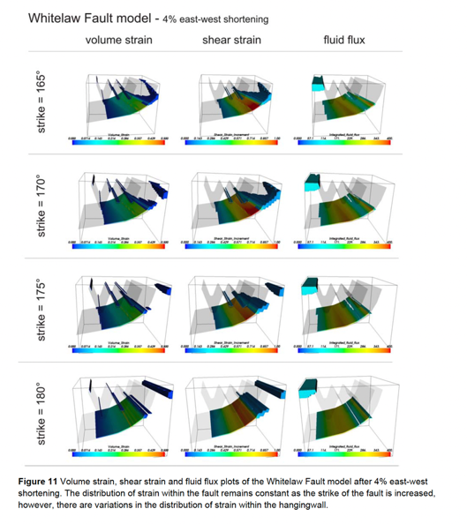
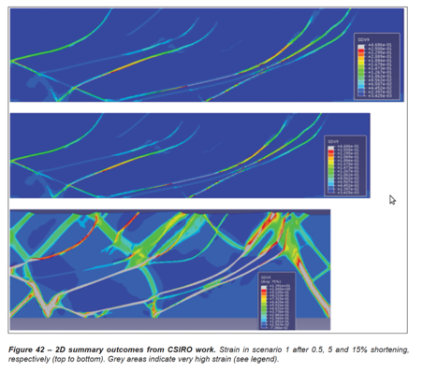
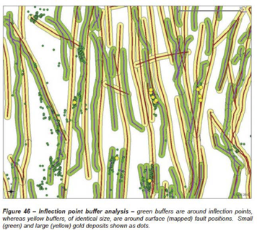
Mapped faults buffer (12,631 km²)
Captured 41% of known deposits
but only 27% of intermediate or larger size.
Inflection Point Buffer (8,744 km²)
Captured 67% of the known deposits
60% of the intermediate and large deposits.
RAWLING, T. J, OSBORNE, C. R., MCLEAN, M.A, SKILADZIEN, P.B ., CAYLEY, R. A. & WILLIAMS, B, ., 2011. 30 Victoria Final Report.
GeoScience Victoria 30 Victoria Report 14. Department of Primary Industries.
LEADER, L. D. & WILSON, C. J. L., 2010. The control of regional-scale fault geometries on strain and
fluid flow related to gold mineralisation: Insights from FLAC3D models constrained by seismic survey
interpretations. GeoScience Victoria Report 11. Department of Primary Industries.
Notes:
Support for the model is provided by FLAC3D and other Numerical modelling. This has confirmed the theoretical aspects of fluid flow during deformation along the low-angle and high angle fault segments. They found that these high fluid fluxes are sustained within the low-dipping segments of the faults. Other modelling by Rawling et al is somewhat equivocal but some of their modelling runs support the concept.
Also Rawling et al did a statistical analysis of the surface outcrops of the intrazone faults compared to the projected inflection points They found that there is much better statistical correspondence between the location of the goldfields and the inflection points compared to the fault outcrops.

Slide 22
Any Plumbing Model
Needs to take into account the geometry of the crustal scale structures – favourable for fluid flow?
Needs to account for crustal composition and the level in the crust that the interaction occurs
- composition has influenced shortening of lower crust by fault imbrication, compared to folding in upper crust
The timing and style of deformation - intrazonal faults propagated eastwards over time

Slide 23
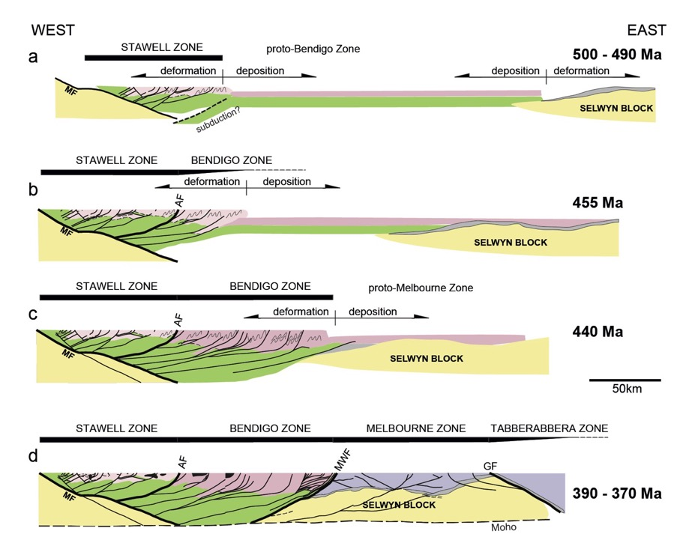
Eastwards progressive deformation has implications for timing of deposit formation
Will deposits be younger in the east?

Slide 24
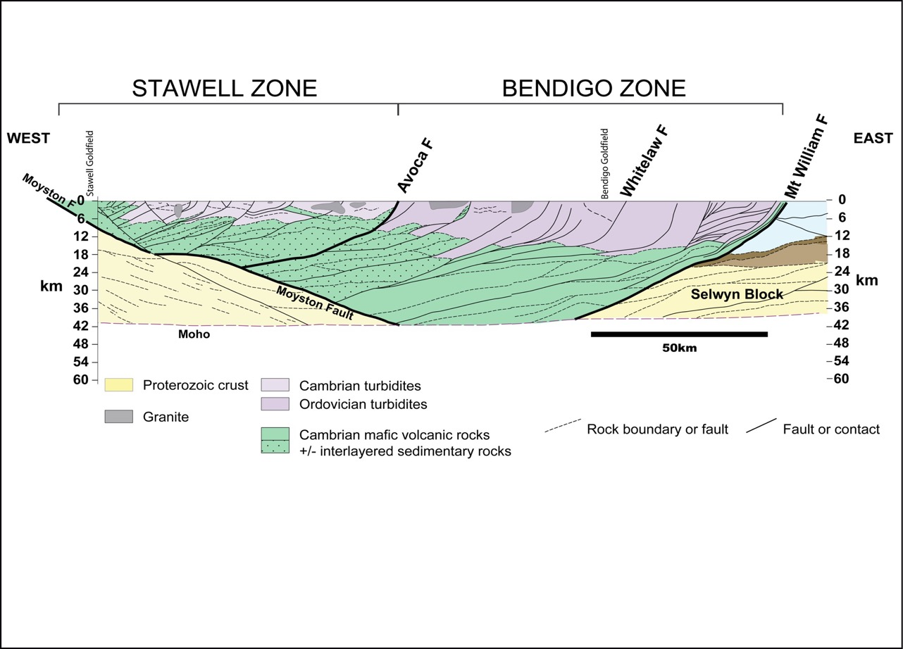
Gold distribution suggests orogen-scale crustal control
140 t Au
2 deposits > 1t
1950 t Au
143 deposits > 1t
Metamorphic
fluid source?
Notes:
Gold deposits occur everywhere across the two zones, but there are two areas where production far exceeds other areas - one in the western Stawell Zone and the other in the central to western Bendigo Zone.
The seismic profiles have revealed this pronounced V-shaped geometry with the east-dipping Moyston Fault in the west and the set of west-dipping listric faults farther east.
So we think these structures may have been important fluid pathways that conveyed metamorphic fluids to the two gold regions. If these faults were major fluid conduits it might suggest that the widely separated gold regions shared a common fluid source area.

Slide 25
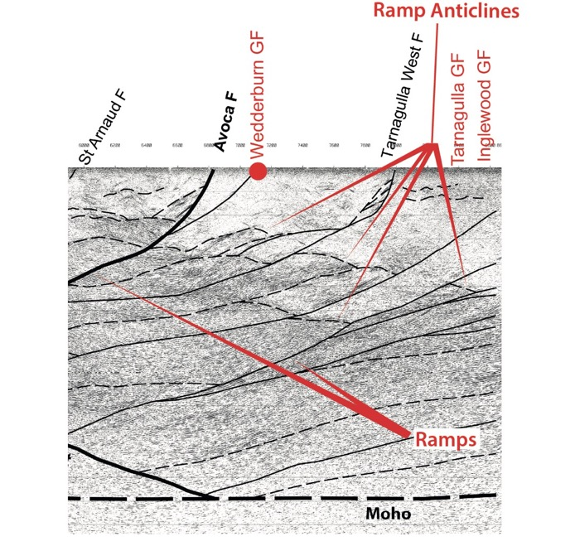
Wedderburn
~27 km north of Seismic Line 1
Sits above a ramp anticline
Inferred Cambrian volcanic sequence 2.5s TWT
or about 7.5 km below surface
Compare with Bendigo where volcanics are at 5 s TWT or about 15 km below
2 sec
4 sec
After Fig 16
R.A. Cayley, R.J. Korsch, D.H. Moore, R.D. Costelloe, A. Nakamura, C.E. Willman, T.J. Rawling, V.J. Morand, P.B. Skladzien, P.J. O'Shea, 2011. Crustal architecture of central Victoria: results from the 2006 deep crustal reflection seismic survey. Australian journal of Earth Sciences 58, pp. 113-156.
14 sec (42 km)

Slide 26
THank You

